Slide 1
디버거 소개
2026.01.22

Slide 2
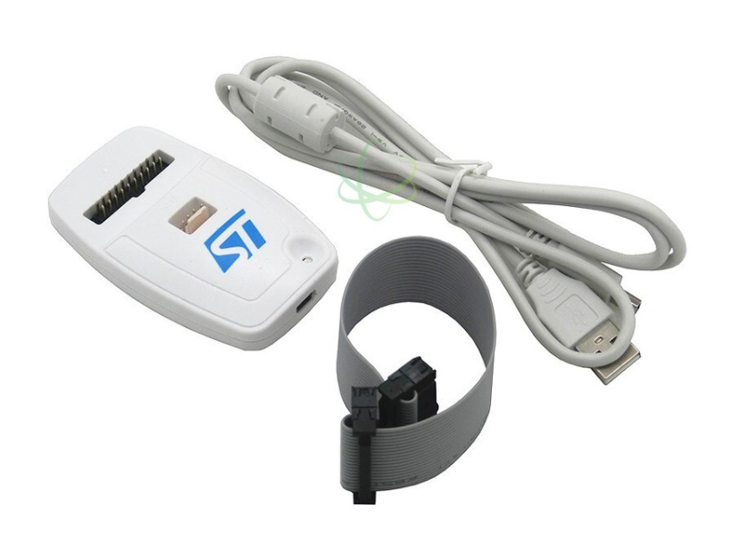
ST-Link V2

Slide 3
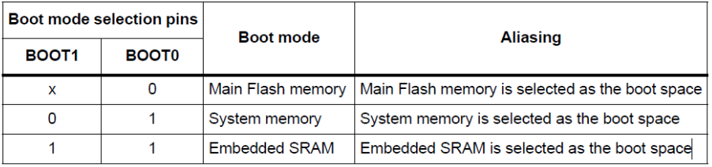
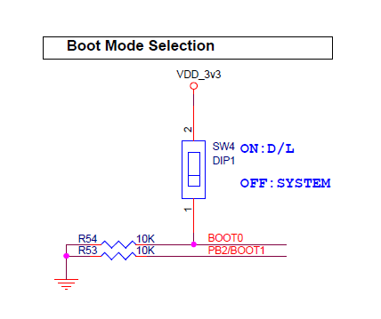
STM32 부트 모드

Slide 4
Linker Script
Main Flash Memory(0x8000000)
STM32F407ZETX_FLASH.ld
Embedded SRAM(0x20000000)
STM32F407ZETX_RAM.ld
Address 정보 - Map 파일 참조
[project_name].map

Slide 5
Vector Table
Linker Script - STM32F407ZETX_FLASH.ld
/* Entry Point */
ENTRY(Reset_Handler)
/* Highest address of the user mode stack */
_estack = ORIGIN(RAM) + LENGTH(RAM); /* end of "RAM" Ram type memory */
_Min_Heap_Size = 0x200; /* required amount of heap */
_Min_Stack_Size = 0x400; /* required amount of stack */
/* Memories definition */
MEMORY
{
CCMRAM (xrw) : ORIGIN = 0x10000000, LENGTH = 64K
RAM (xrw) : ORIGIN = 0x20000000, LENGTH = 128K
FLASH (rx) : ORIGIN = 0x8000000, LENGTH = 512K
}
/* Sections */
SECTIONS
{
/* The startup code into "FLASH" Rom type memory */
.isr_vector :
{
. = ALIGN(4);
KEEP(*(.isr_vector)) /* Startup code */
. = ALIGN(4);
} >FLASH

Slide 6
Vector Table - startup_stm32f407zetx.s
.section .isr_vector,"a",%progbits
.type g_pfnVectors, %object
g_pfnVectors:
.word _estack
.word Reset_Handler
.word NMI_Handler
.word HardFault_Handler
.word MemManage_Handler
.word BusFault_Handler
.word UsageFault_Handler
.word 0
.word 0
.word 0
.word 0
.word SVC_Handler
.word DebugMon_Handler
.word 0
.word PendSV_Handler
.word SysTick_Handler

Slide 7
Vector Table - startup_stm32f407zetx.s
.word WWDG_IRQHandler
.word PVD_IRQHandler
.word TAMP_STAMP_IRQHandler
.word RTC_WKUP_IRQHandler
.word 0 /* Reserved */
.word RCC_IRQHandler
.word EXTI0_IRQHandler
.word EXTI1_IRQHandler
.word EXTI2_IRQHandler
.word EXTI3_IRQHandler
.word EXTI4_IRQHandler

Slide 8
Vector Table – Reset Handler
.section .text.Reset_Handler
.weak Reset_Handler
.type Reset_Handler, %function
Reset_Handler:
ldr r0, =_estack
mov sp, r0 /* set stack pointer */
/* Call the clock system initialization function.*/
bl SystemInit
/* Copy the data segment initializers from flash to SRAM */
ldr r0, =_sdata
ldr r1, =_edata
ldr r2, =_sidata
movs r3, #0
b LoopCopyDataInit
CopyDataInit:
ldr r4, [r2, r3]
str r4, [r0, r3]
adds r3, r3, #4
LoopCopyDataInit:
adds r4, r0, r3
cmp r4, r1
bcc CopyDataInit

Slide 9
Debugger View
Memory View – 0x00번지 Vector Table 확인

Slide 10
Debugger View
Register View
– R0 ~ R12, SP, LR, PC, PSR, CONTROL 확인
– 변경 가능

Slide 11
Debugger
Breakpoint 설정
Step-in, Step-over, Return
Call Stack 확인
Variable Watch & Modify
Peripheral Register View & Modify
Firmware download – Flash programming

